Slide 1
Test of Hypothesis (1)
Md. Ismail Hossain Riday

Slide 2
Hypothesis
A hypothesis is an assumption/statement to be tested.

Slide 3
Statistical hypothesis
A statistical hypothesis is some statement
About a population parameter
Which we want to verify
On the basis of sample information.
Getting population data is hard because there's a lot of it.
Getting sample data is easy

Slide 4
Statistical hypothesis
A statistical hypothesis is some statement about a population parameter or about the probability distribution characterizing a population which we want to verify on the basis of sample information.
Example: A physician may hypothesize that the recommended drug is effective is 99% cases.

Slide 5
Statistical hypothesis
I think…
No, I think…

Slide 6
Types of Statistical hypothesis
Two types of statistical hypothesis
Hypothesis

Slide 7
Types of Statistical hypothesis
Two types of statistical hypothesis
Hypothesis
Null

Slide 8
Types of Statistical hypothesis
Two types of statistical hypothesis
Hypothesis
Alternative
Null

Slide 9

Null hypothesis
A null hypothesis is a statistical hypothesis that contains a statement of equality
$≤or=or≥$
Denoted by $H_{0}$

Slide 10
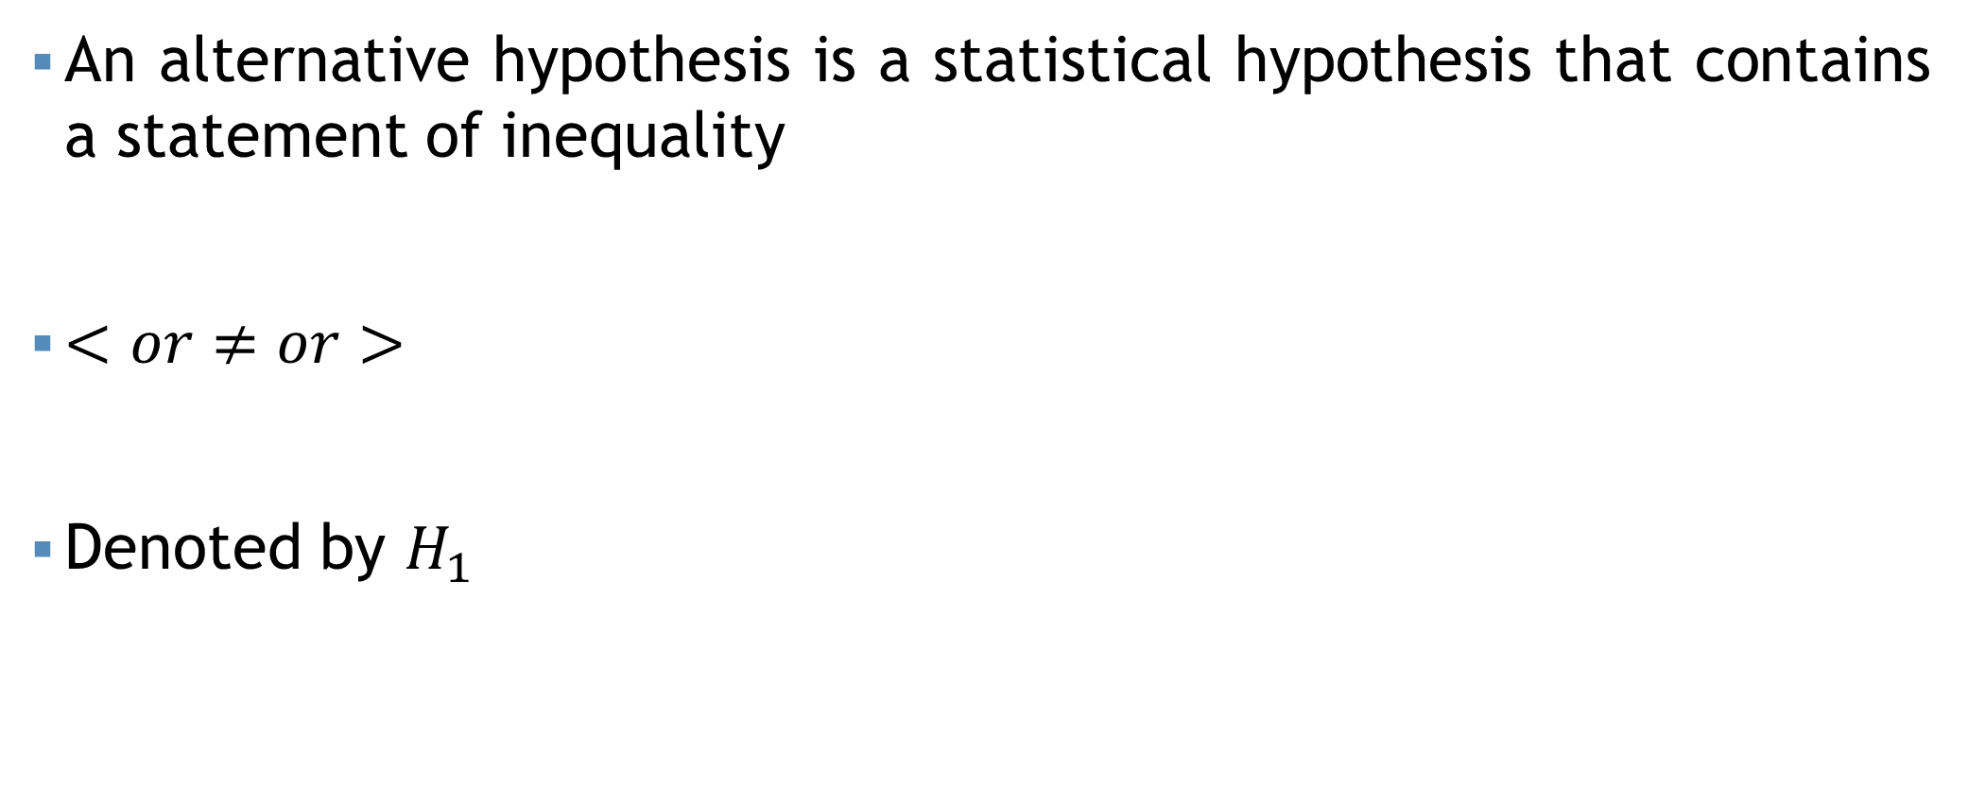
Alternative hypothesis
An alternative hypothesis is a statistical hypothesis that contains a statement of inequality
$<or≠or>$
Denoted by $H_{1}$

Slide 11


Example
CSE students' average programming skills are the same whether or not they attend a coding bootcamp.
$$H_{0}$$
CSE students' average programming skills are different depending on whether or not they attend a coding bootcamp
$$H_{1}$$

Slide 12


Example
A company collects information on the retail price of books and publishes the data in the website. In 2005, the mean retail price of history books was $78.01. Suppose that we want to perform a hypothesis test to decide whether these years mean retail price of history books has increases from the 2005 mean. Determine the null and alternative hypotheses.
$$H_{0}:μ=78.01$$
$$H_{1}:μ>78.01$$

Slide 13
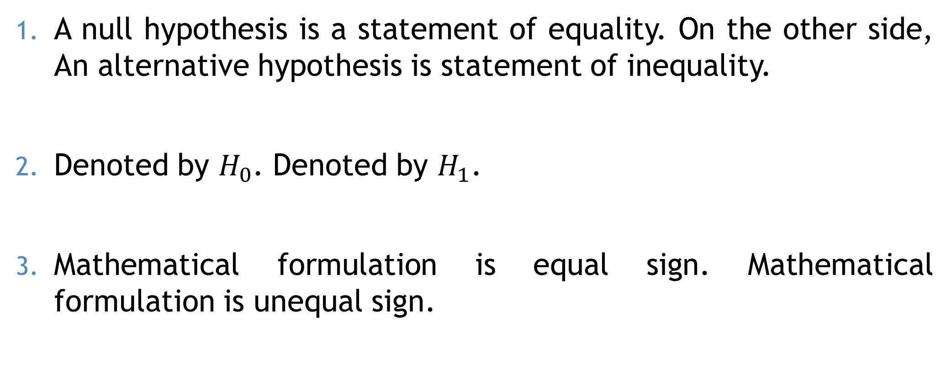
Difference
A null hypothesis is a statement of equality. On the other side, An alternative hypothesis is statement of inequality.
Denoted by $H_{0}$. Denoted by $H_{1}$.
Mathematical formulation is equal sign. Mathematical formulation is unequal sign.

Slide 14



Test Statistic
Verify on the basis of sample information
Population function
Parameter
Sample function
Statistic
Test Statistic
Z test
$$n≥30$$
t test
$$n<30$$
F test
$χ^{2}$ test

Slide 15



Example
The mean life time of a sample of 100 light tubes produced by a company is found to be 1570 hours with standard deviation of 80 hours. Test the hypothesis that the mean life time of the tubes produced by the company is 1600 hours.
$$H_{0}:μ=1600$$
$$z test$$
$$H_{1}:μ≠1600$$

Slide 16



Example
Is the temperature required to damage a computer on the average less than 110 degrees? Because of the price of testing, twenty computers were tested to see what minimum temperature will damage the computer. The damaging temperature averaged 109 degrees with a standard deviation of 3 degrees.
$$H_{0}:μ≥110$$
$$t test$$
$$H_{1}:μ<110$$

Slide 17
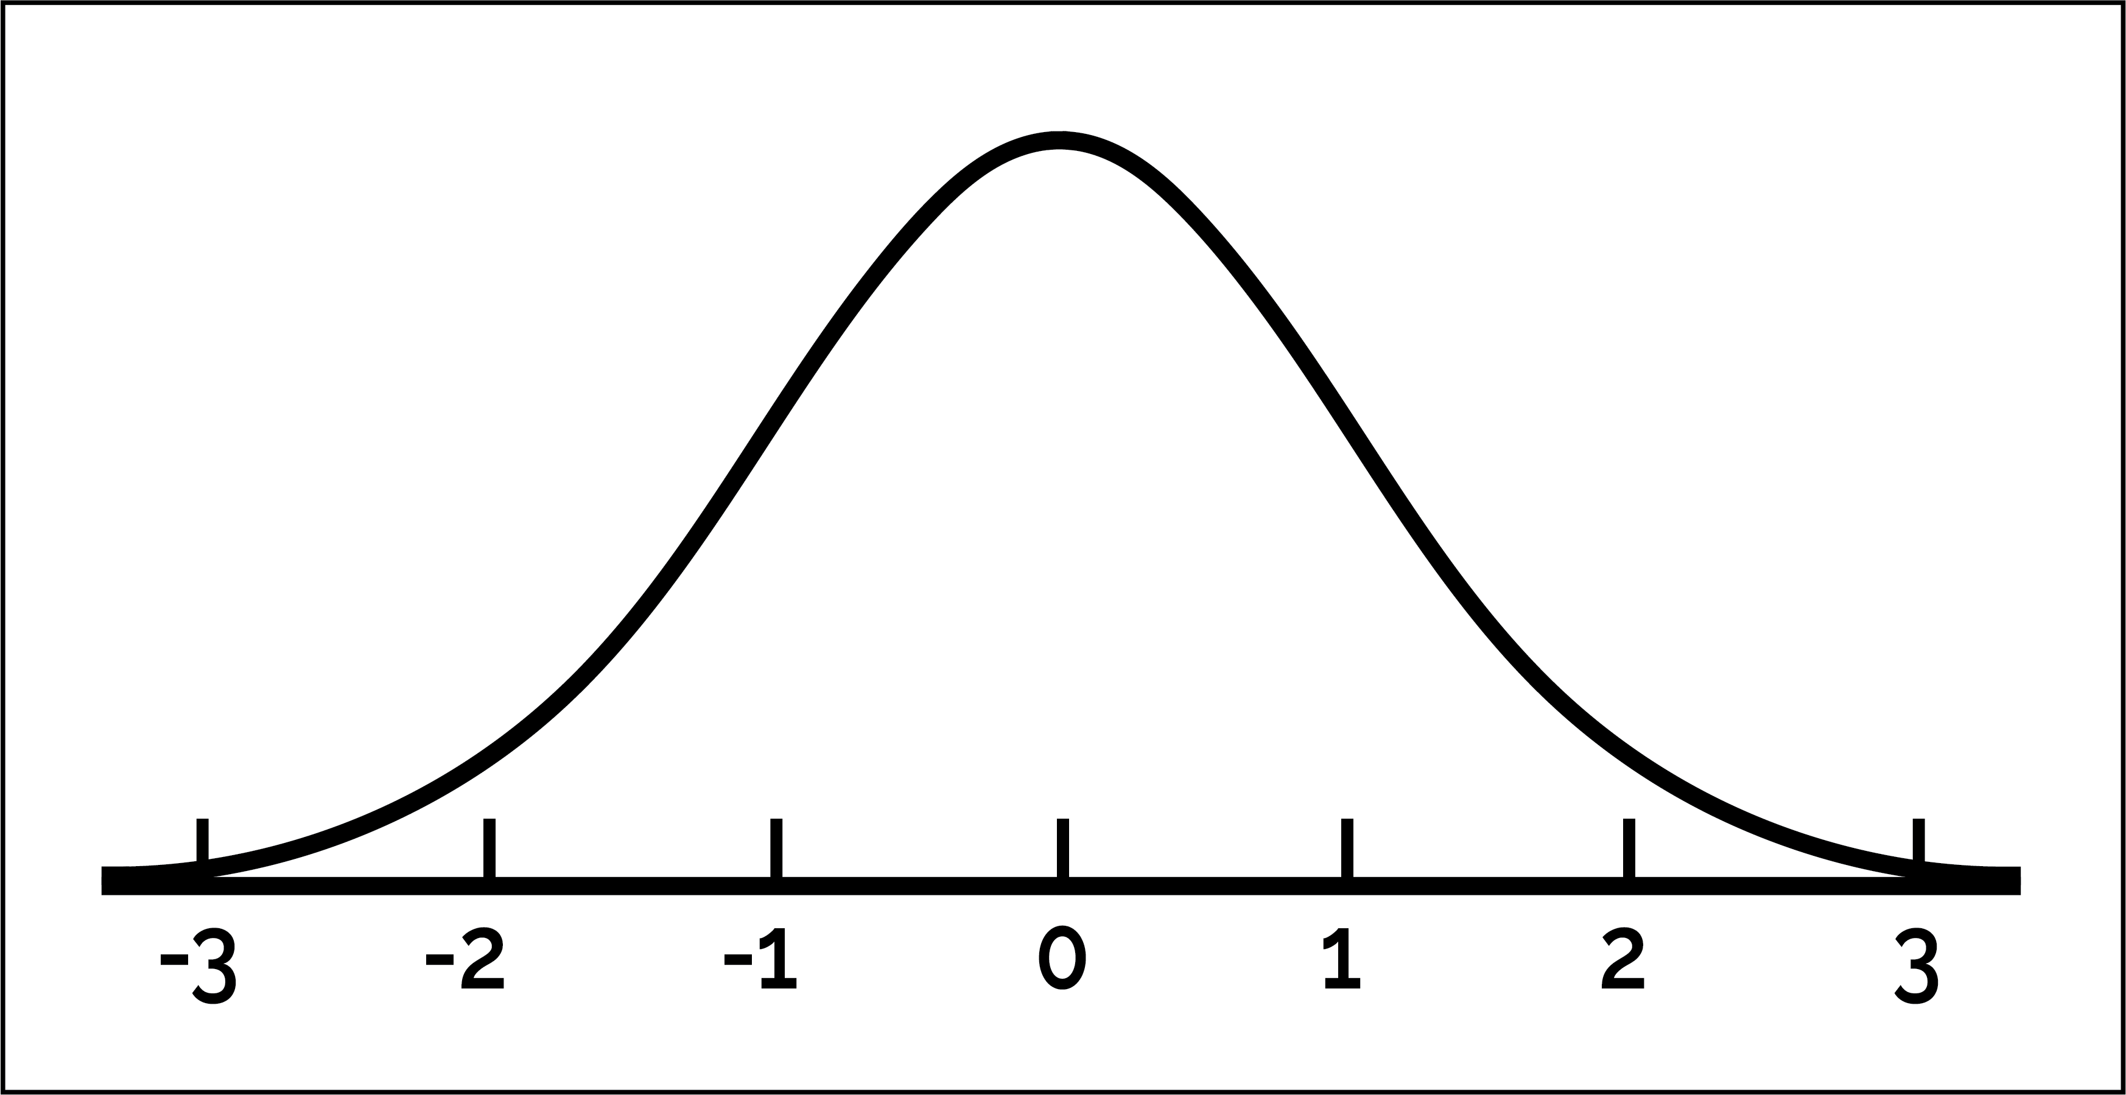

Rejection Region
The region where we may reject our hypothesis.
Rejection Region $(α)$

Slide 18


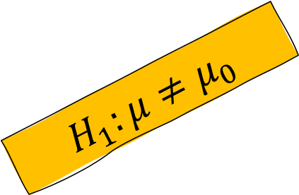

Type of tailed
Right tailed test
$$H_{1}:μ>μ_{0}$$
There are two types:
One tailed test
Two tailed test
Entire rejection region lies one side
$$H_{1}:μ≠μ_{0}$$
Entire rejection region lies two side
Left tailed test
$$H_{1}:μ<μ_{0}$$

Slide 19

Example
The mean life time of a sample of 100 light tubes produced by a company is found to be 1570 hours with standard deviation of 80 hours. Test the hypothesis that the mean life time of the tubes produced by the company is 1600 hours.
$$H_{0}:μ=1600$$
$$Two Tailed Test$$
$$H_{1}:μ≠1600$$

Slide 20

Example
Is the temperature required to damage a computer on the average less than 110 degrees? Because of the price of testing, twenty computers were tested to see what minimum temperature will damage the computer. The damaging temperature averaged 109 degrees with a standard deviation of 3 degrees.
$$H_{0}:μ≥110$$
$$Left Tailed Test$$
$$H_{1}:μ<110$$

Slide 21

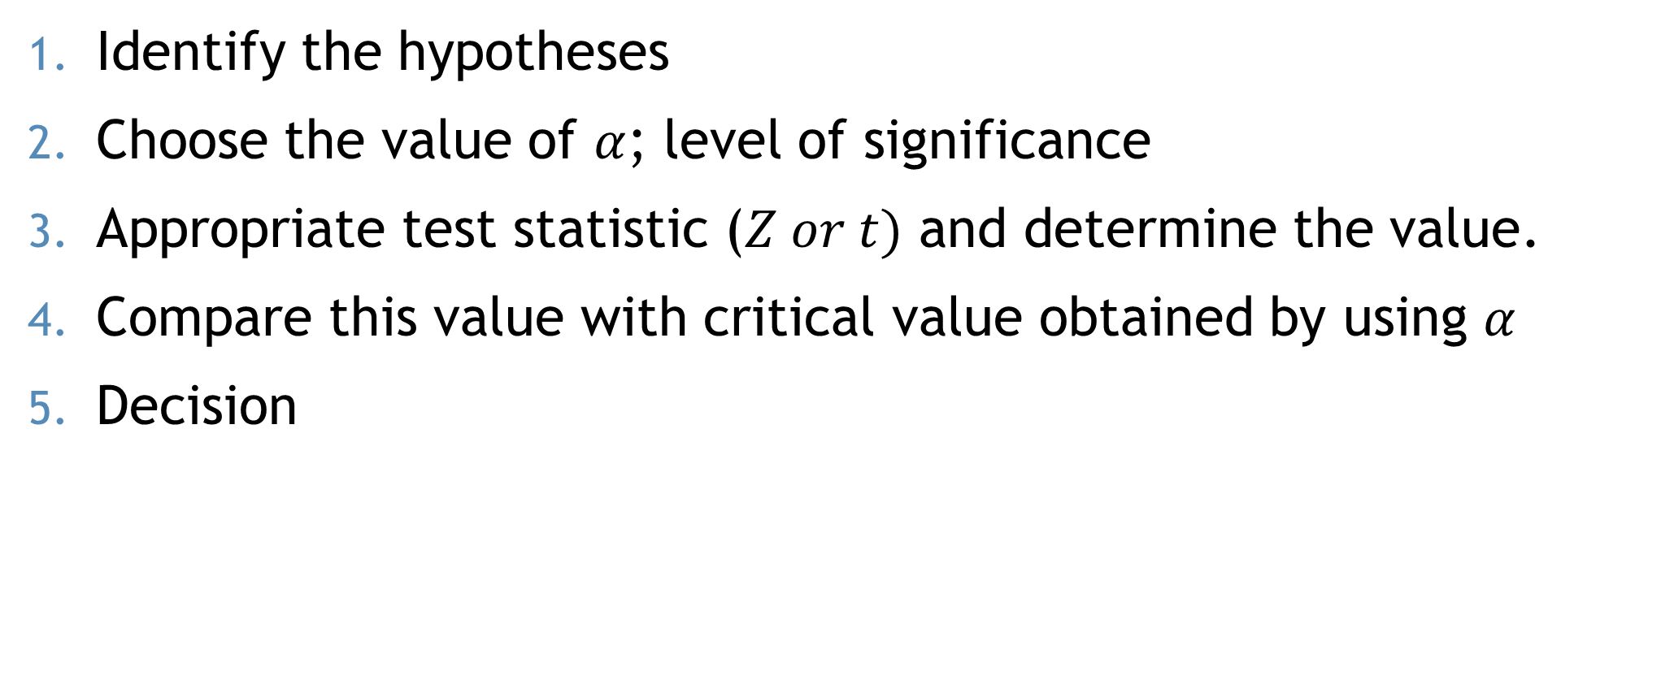



Steps (Z Test)
$$t =\frac{\overline{X}−μ_{0}}{\frac{s}{\sqrt{n}}}$$
$$Z =\frac{\overline{X}−μ_{0}}{\frac{σ}{\sqrt{n}}}$$
Identify the hypotheses
Choose the value of $α$; level of significance
Appropriate test statistic ($Z or t)$ and determine the value.
Compare this value with critical value obtained by using $α$
Decision
Critical value: When $α=0.05$
For one tailed: $Z_{α}=1.645$
For two tailed: $Z_{\frac{α}{2}}=1.96$
Critical value: When $α=0.01$
For one tailed: $Z_{α}=2.33$
For two tailed: $Z_{\frac{α}{2}}=2.56$
Decision: We may reject $H_{0}$ if,
For left tailed: $Z_{cal}≤−\left(Z_{α}\right)$
For right tailed: $Z_{cal}≥{+(Z}_{α})$
For two tailed: $\left|Z_{cal}\right|≥Z_{\frac{α}{2}}$

Slide 22


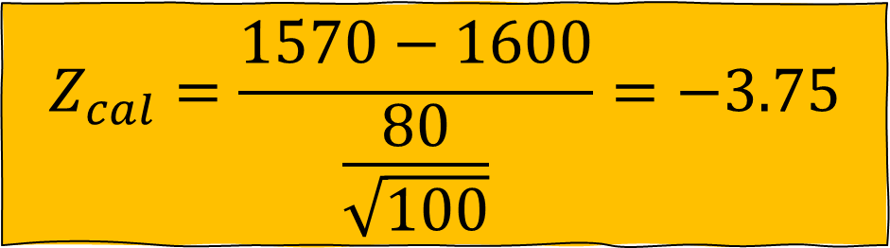


Example
$$H_{0}:μ=1600$$
$$H_{1}:μ≠1600$$
$$α=0.05$$
The mean life time of a sample of 100 light tubes produced by a company is found to be 1570 hours with standard deviation of 80 hours. Test the hypothesis that the mean life time of the tubes produced by the company is 1600 hours.
$$Z_{cal}=\frac{\overline{X}−μ_{0}}{\frac{σ}{\sqrt{n}}}$$
$$Z_{cal}=\frac{1570−1600}{\frac{80}{\sqrt{100}}}=−3.75$$

Slide 23






Example
$$H_{0}:μ=1600$$
$$Z_{cal}=\frac{1570−1600}{\frac{80}{\sqrt{100}}}=−3.75$$
$$H_{1}:μ≠1600$$
$$α=0.05$$
The mean life time of a sample of 100 light tubes produced by a company is found to be 1570 hours with standard deviation of 80 hours. Test the hypothesis that the mean life time of the tubes produced by the company is 1600 hours.
Critical value: When $α=0.05$
For one tailed: $Z_{α}=1.645$
For two tailed: $Z_{\frac{α}{2}}=1.96$
Critical value: When $α=0.01$
For one tailed: $Z_{α}=2.33$
For two tailed: $Z_{\frac{α}{2}}=2.56$
$$Z_{tab}=1.96$$
Decision: We may reject $H_{0}$ if,
For left tailed: $Z_{cal}≤{−Z}_{α}$
For right tailed: $Z_{cal}≥{+Z}_{α}$
For two tailed: $\left|Z_{cal}\right|≥Z_{\frac{α}{2}}$
$$\left|Z_{cal}\right|>Z_{tab}$$
$$Reject H_{0}$$

Slide 24
Example
A sample of 400 male students is found to have a mean height 67.47 inches. Can it be reasonably regarded as a sample from a large population with mean height 67.39 inches and standard deviation 1.30 inches? Test at 5% level of significance.

Slide 25
Example
Suppose that it is known from experience that the standard deviation of the weight of 8 ounces packages of cookies made by a certain bakery is 0.16 ounces. To check its production is under control on a given day, the true average of the packages is 8 ounces, they select a random sample of 40 packages and find their mean weight is 8.122 ounces. Test whether the production is under control or not at 5% level of significance.

Slide 26
Mathematical exercise
To access additional mathematical problems, please refer to the PDF lecture notes.

Slide 27
Thank You

